Slide 1
Agile Essentials
Matthew Harsh, MBA, CSM Manager / SWO Sr. Automation Architect
Matthew.Harsh@us.sogeti.com
937-974-7939

Slide 2
True or False
Agile is a new way of doing things.
False:
Agile methodologies have been around since the early 90s.

Slide 3
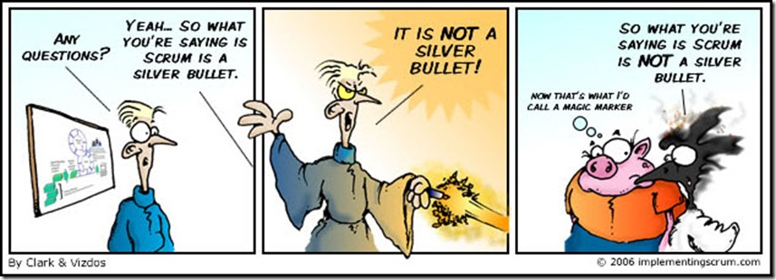
True or False
Agile solves the problems of software development.
False:
Agile is not a silver bullet. It won’t solve all your problems, but will expose them.

Slide 4
True or False
In an Agile environment, working software is the primary measure of progress.
True:
Working software shows true progress. If a project is going to fail, you will know it sooner rather than later.
Transparency
Notes:
Too often teams don’t realize a project is going to fail until they are near the end of the project. Working software shows true progress and if a project is going to fail, it’s better to know sooner rather than later

Slide 5
What is Agile?
ag·ile (in a software context)
[a group of software development methodologies]
[based on iterative and incremental development,]
[where requirements and solutions evolve through collaboration]
[between self-organizing, cross-functional teams.]

Slide 6
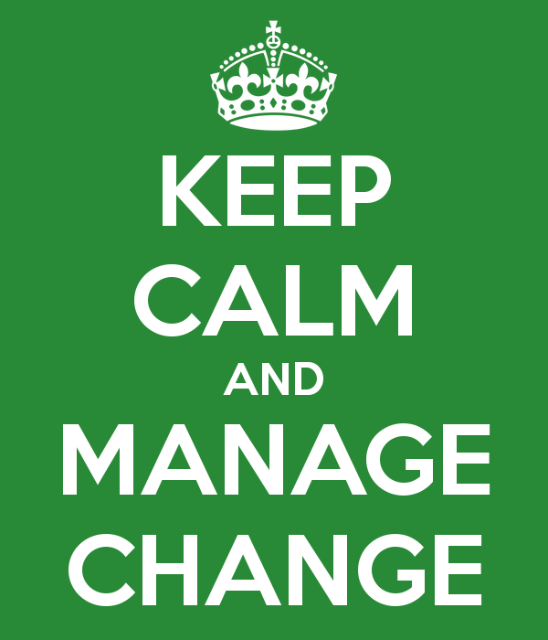
Reprogram your Brain
Existing Code
Refactored
Strive for efficiency
Deliver on the planned result
Planning drives results
Establish procedures and policies
Control the process
Correct to the baseline
Be a task master
Get it right the first time
Strive for productivity
Discover the desired result
Results drive planning
Agree on principles and values
Keep flexible and adaptive
Correct to what's possible
Be a relationship manager
Get it right the last time
Traditional Mindset
Stability is the norm
World is linear and predictable
Do agile
It's controllable
Minimize change
Agile Mindset
Flexibility is the norm
Uncertainty reigns
Be agile
Murphy's law rules
Welcome change

Slide 7
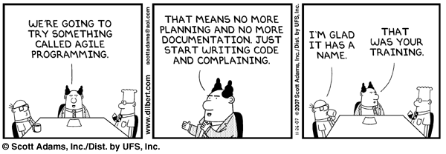
Agile – Dispelling the Myths
Notes:
11) The best designs emerge from iterative development. The best creativity and solutions come from teams in which interactions are high. Feed off of each other, learn from each other.
12) Look for ways to improve and act on it.

Slide 8
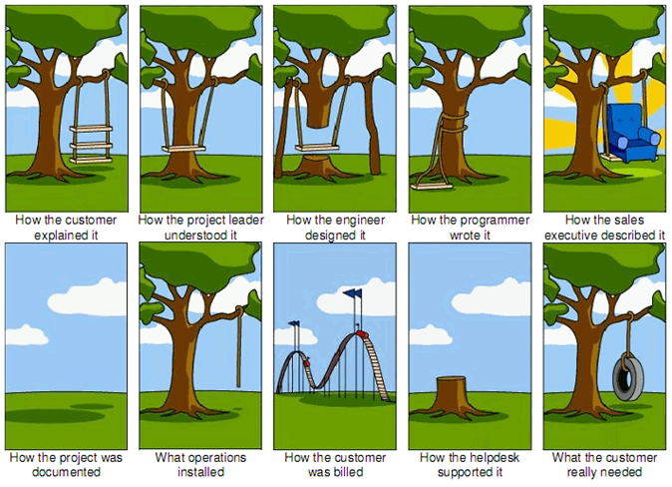
Why Agile?
In spite of appearances, people very seldom know what they want until you give them what they asked for
Donald C. Gause and Gerald M. Weinberg, Computer Scientists

Slide 9
Pillars of Agile
Transparency
Inspection
Adaptation

Slide 10

Exercise

Slide 11
Agile Manifesto – Agile Values
We are uncovering better ways of developing software by doing it and helping others do it. Through this work we have come to value:
That is, while there is value in the items on the right, we value the items on the left more.
Individuals and Interactions
over
Processes and Tools
Working Software
over
Comprehensive Documentation
Customer Collaboration
over
Contract Negotiation
Responding to Change
Following a Plan
over
Notes:
Uncovering, Doing It, Helping Others

Slide 12
Agile Manifesto – Agile Principles
1. Our highest priority is to satisfy the customer through early and continuous delivery of valuable software.
2. Welcome changing requirements, even late in development. Agile Processes harness change for the customer’s competitive advantage.
Notes:
Customers care whether or not you are delivering working software, not about whether you have created requirements or architectural documents. They are important but our focus should be on delivering working software.
The future is unpredictable. Requirements change, needs change. In order to be competitive, we need to welcome changing requirements.

Slide 13
Agile Principles
3. Deliver working software frequently, from a couple of weeks to a couple of months, with a preference for the shorter timescale.
4. Business people and developers work together daily throughout the project.
Notes:
Deliver does not mean the same as “release”. It may not be justifiable to release to production but you should deliver internally frequently to allow for learn from the growing project.
That’s the only way for the team to know what they are to deliver, or what the customer really wants/needs. This also allows for the customer to take some responsibility of the project.

Slide 14
Agile Principles
5. Build projects around motivated individuals, give them the environment and support they need and trust them to get the job done.
6. The most efficient and effective method of conveying information with and within a development team is face-to-face conversation.
Notes:
5) People make the difference between success or failure no matter how many tools and processes you put in place. We need to trust the people doing the work to make decisions.
6) We all know how telephone tag turns out. When you communicate face to face, you know that your message is being received correctly and there is less chance of a misunderstanding. The best collaboration is face to face.

Slide 15
Agile Principles
7. Working software is the primary measure of progress.
8. Agile processes promote sustainable development. The sponsors, developers and users should be able to maintain a constant pace indefinitely.
Notes:
7) Too often teams don’t realize a project is going to fail until they are near the end of the project. Working software shows true progress and if a project is going to fail, it’s better to know sooner rather than later.
8) How many of you have worked on projects where you worked many late nights or weekends? Sustainable development means finding a workpace a team can maintain and still be alert and productive.

Slide 16
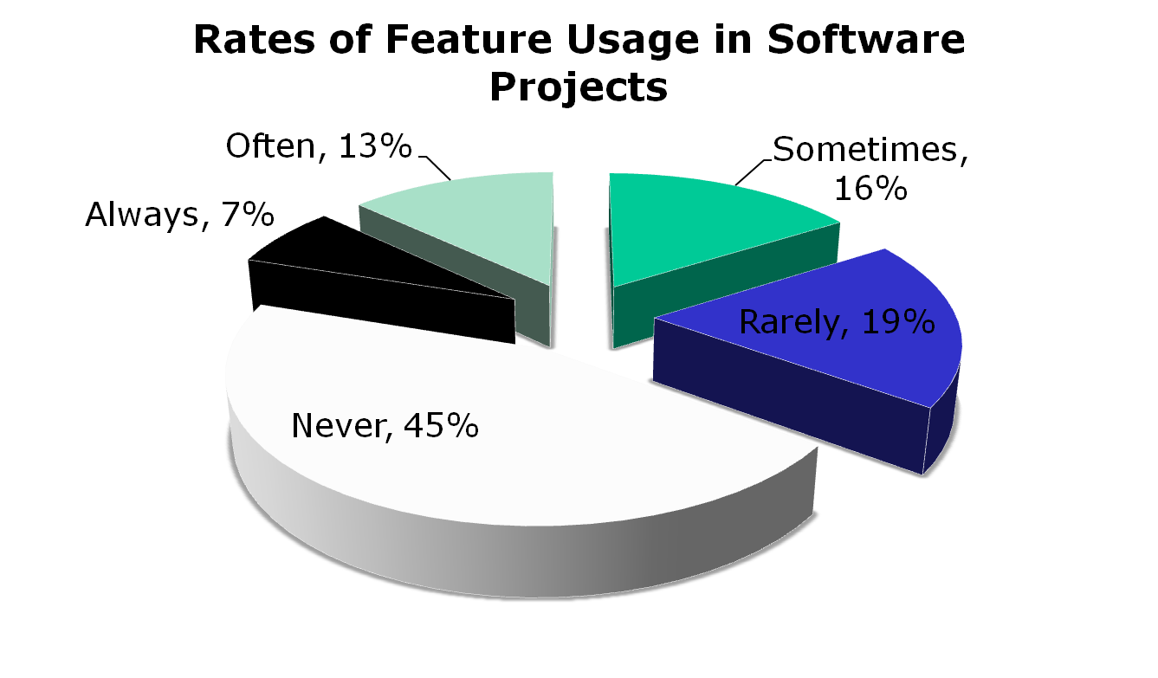
Agile Principles
9. Continuous attention to technical excellence and good design enhances agility.
10. Simplicity – the art of maximizing the amount of work not done – is essential.
Always or Often Used 20%
Sometimes, Never, or Rarely Used 80%
Notes:
9) Quality of design is essential to maintaining agility. It must be a continuous activity performed throughout the project and not just an up-front activity.
10) Easier to add to something simple versus taking away from something complex.

Slide 17
Agile Principles
11. The best architectures, requirements and designs emerge from self-organizing teams.
12. At regular intervals, the team reflects on how to become more effective, then tunes and adjusts it’s behavior accordingly.
Notes:
11) The best designs emerge from iterative development. The best creativity and solutions come from teams in which interactions are high. Feed off of each other, learn from each other.
12) Look for ways to improve and act on it.

Slide 18
Agile Principles
Pocket Principles
1.
2.
3.
4.
5.
6.
7.
8.
9.
10.
11.
12.

Slide 19
Agile & Scrum
Scrum
Agile
Agile and Scrum go together. If you are not compliant with the Agile Manifesto you are not compliant with Scrum (ScrumBut). If you don’t have working software at the end of the sprint, then not only are you “ScrumBut” but you aren’t even Agile. – Jeff Sutherland
Notes:
Agile and Scrum go together. If you are not compliant with the Agile Manifesto you are not compliant with Scrum (ScrumBut). If you don’t have working software at the end of the sprint, then not only are you “ScrumBut” but you aren’t even Agile. – Jeff Sutherland

Slide 20
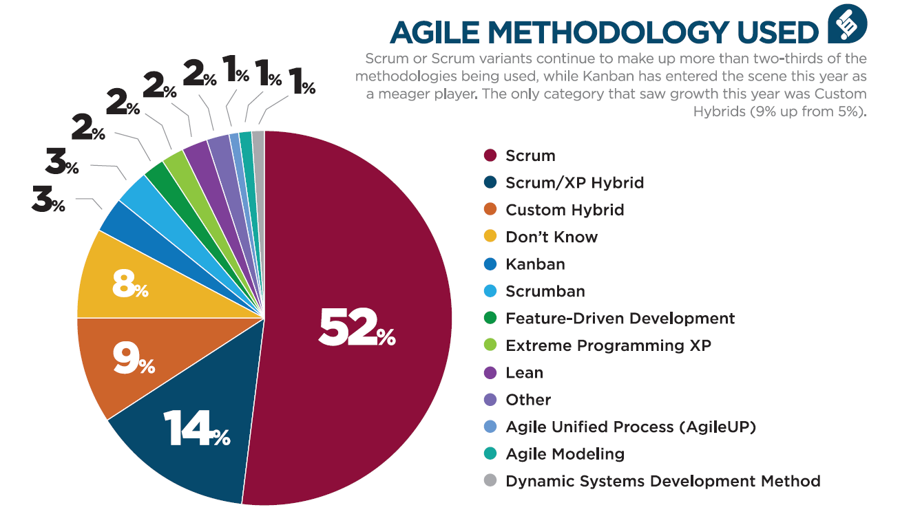
Flavors of Agile
Notes:
Scrum is an empirical process to focus on delivering the highest business value in the shortest time.
Empirical in that is, observable, provable and verifiable from experience
Agile software development is a different prospective from traditional waterfall Project management
Characteristics:
Release code early and often
Adapt process and product to new information
Always production quality
Complementary principals and practices
Scrum fits under the Agile software development umbrella- as a ….
Framework, not a methodology – you redefine the process each iteration (sprint), if needed

Slide 21
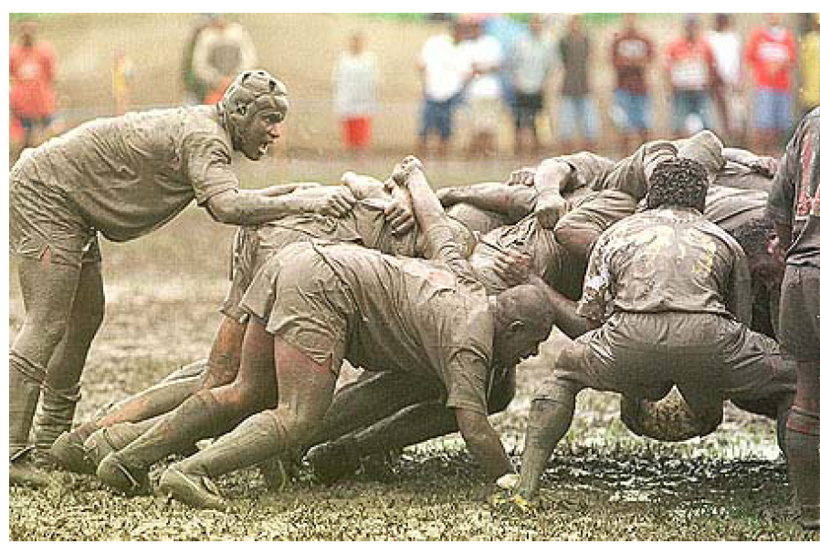
What is Scrum?
Notes:
In Rugby it is a way to restart play where a bound group of players form a tunnel with the opposition or infringement.
Scrum is a lightweight agile method for software development.

Slide 22

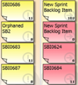

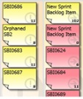

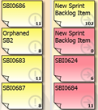
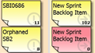
Scrum Framework SOAP – Scrum on a Page
3 Roles 3 Artifacts 4 Ceremonies
Daily
Scrum
Release Planning
(Iterative R2,R3, Rn
Sprint
(Iterative)
Product
PO Vision
Features
Roadmap
Goals
Product Backlog
Modules
Epics
User Stories
‘Right
size’
Story
Release
Planning
Pointed
Prioritized
Add
Story
Detail
AC
Sprint
Planning
Understand
Define Tasks
Commit
2-4 hours
Sprint
Develop, test
2-4 weeks
Daily Scrum
15min
Sprint
Review
Demo
Accept
2-4 hrs
Retrospective
Continuous improvement
~2 hrs

Slide 23


3 Scrum Roles
Defines the Product Vision
Accountable for product success
Ensures the Team is working on the highest value features (prioritizes stories)
Has final authority on WHAT gets developed (not how)
Has authority and availability to make timely decisions
Product Owner
Servant Leader
Serves the Development Team
Facilitates Ceremonies
Coaches and Mentors the Team
Removes Impediments
Protects the Team
Serves the Product Owner
Backlog Mgmt
Product Planning
Serves the Organization
Ensures Agile Principles are upheld
Scrum Master

Slide 24







3 Scrum Roles
Cross Functional: Includes all disciplines necessary to take a story from inception to “done”
Self-organized: Executes and “manages” the work
Highly collaborative
Accountable: All team members are accountable for completing the work
Ideal Size: 6 +/- 3
Development Team
Development Team
Testers
UI DEsigners
QA Engineers
Requirements Analysts
Architects
Test Leads
Programmers
DBA

Slide 25
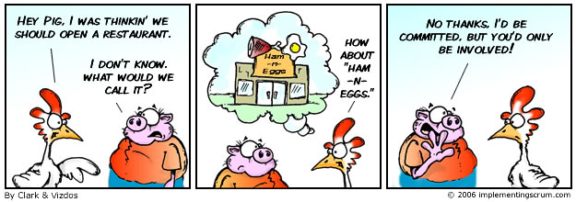
Pigs & Chickens
Scrum Master
Development Team
Product Owner
Everyone Else

Slide 26
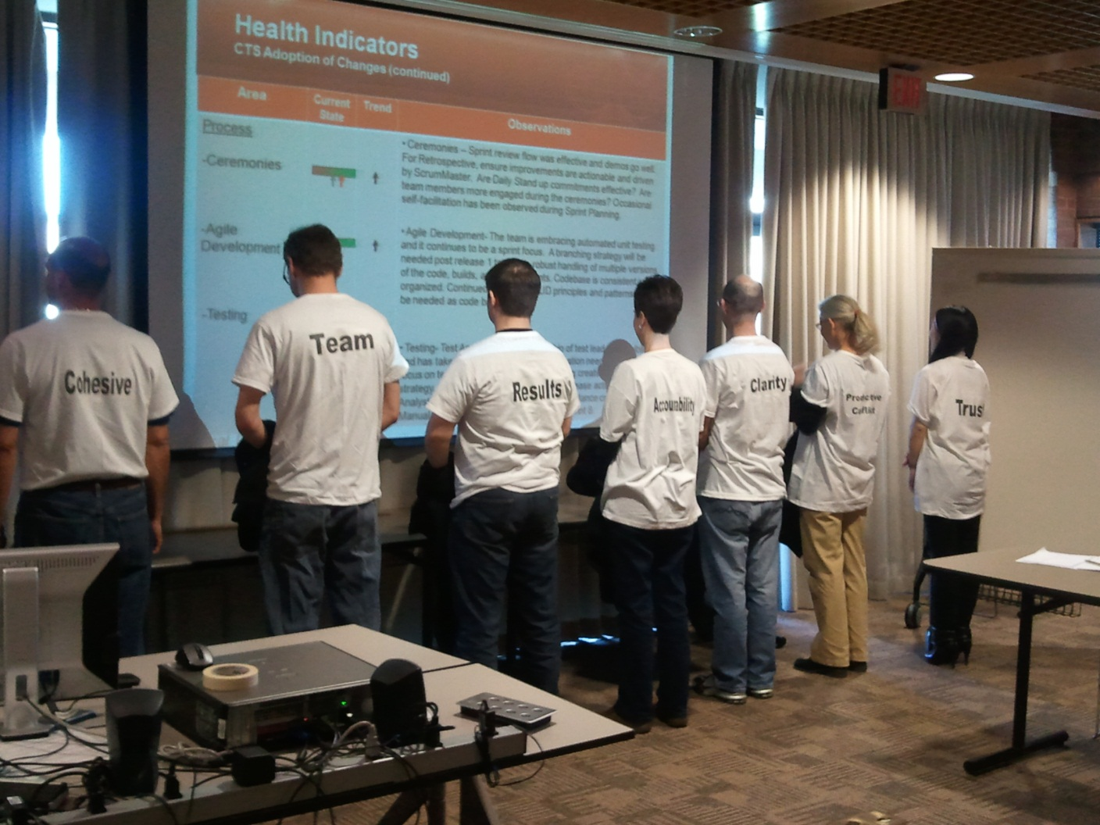
Self-organized
Cohesive Team =
Trust
Productive Conflict
Commitment
Accountability
Results
* 5 Dysfunctions of a Team – Patrick Lencioni

Slide 27
Exercise

Slide 28
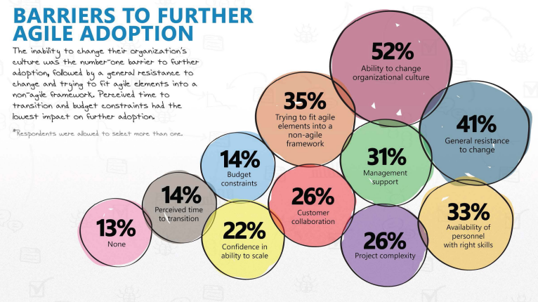
Version One Survey - http://www.versionone.com/pdf/7th-Annual-State-of-Agile-Development-Survey.pdf

Slide 29
Review
Who directs/assigns the team’s work?
The Team
Who ensures Agile Values & Principles are followed?
The Scrum Master
Who makes the business decisions?
The Product Owner

Slide 30
Review
Who is responsible for the quality of the product?
The Team
Who is accountable for the success of the project?
The Product Owner
The Product Owner is the only one responsible for defining business requirements?
False! The Team, SMEs and Product Owner collaborate on the detail of the Product Backlog Items.

Slide 31


3 Scrum Artifacts
Prioritized list of User Stories (aka requirements)…and Bugs, Architecture Stories, and Technical Debt
Sample
Who:
Anyone can contribute
BA is normally the facilitator/keeper
PO is the owner – final authority
Product Backlog
List of Stories, Bugs and Tasks that the Team has committed to completing in the current Sprint
NOT prioritized, as the goal is complete the ENTIRE Sprint Backlog by the end of the Sprint
Mechanism for tracking work during the course of the Sprint
Sprint Backlog

Slide 32
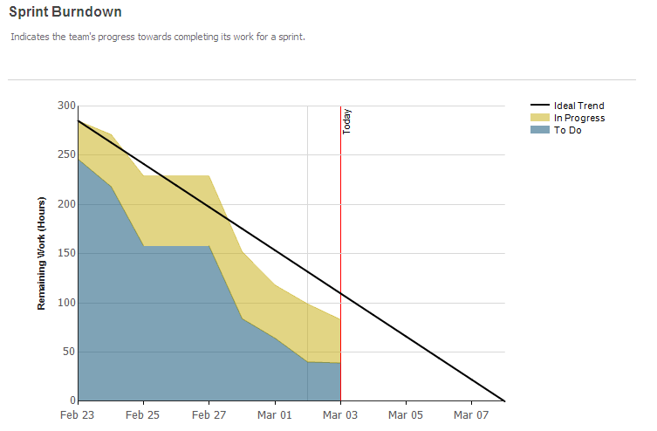
3 Scrum Artifacts
Burndown Chart

Slide 33
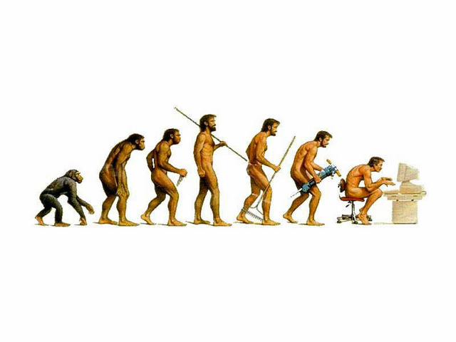
A Bit More on the Product Backlog
Product Backlog Creation & Evolution
Derived from the Product Vision & Process Maps
Product Owner creates the Product Vision
Business creates Business Process Maps
Product Team creates one or more stories per identified step in Process Map
OK to make assumptions, will verify with PO and/or Business SMEs
Stories will be added/modified/removed throughout the project lifecycle
Goal to write stories for as much of the product as possible during Sprint 0
Specific focus on creating ‘Right-Sized’ stories for the initial module/release with higher ‘Epic’ level stories created for lower priority modules

Slide 34
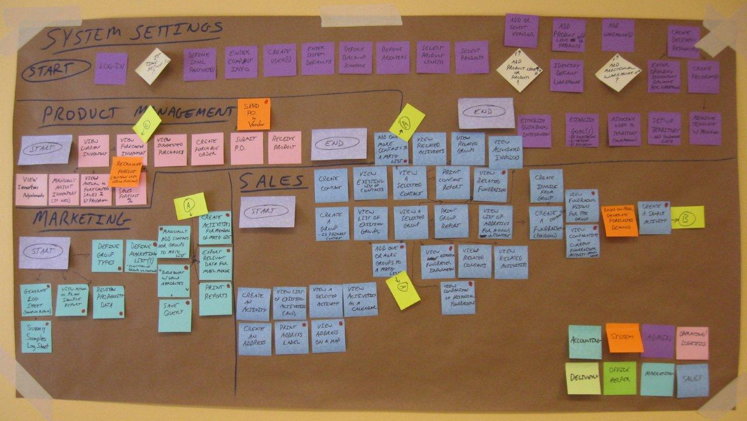
Sample Process Map - Brown Paper

Slide 35
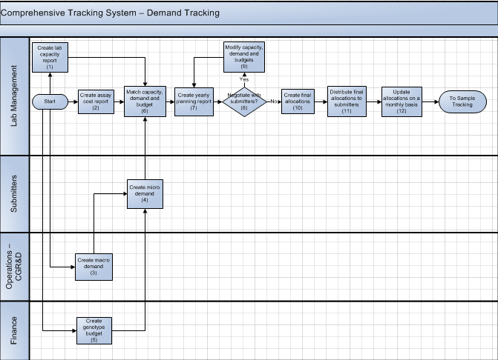
Sample Process Map
Participants:
Scrum Master
Product Owner
Business SMEs
BAs
Others as makes sense
Utilized by Development Team throughout the Scrum project

Slide 36
What is a User Story?
Simple, clear, brief description of functionality that will be valuable to the USER
Role (Who?) + Goal (What?) + Reason (Why?)
May start with modules, then features, then drill down into “right sized” stories
Module
Feature
“Right-Sized” User Story
Invoicing
As an accountant, I need to create an invoice
As an accountant, I need to print an invoice
As an accountant, I need to receive payment against an invoice
As an accountant, I need to save an invoice
As an accountant, I need to send an invoice to a customer
Notes:
just enough information so that the development team can produce a reasonable estimate of the effort to implement it
Independent
Stories are easiest to work with if they do not overlap in concept, and can be scheduled and implemented in any order.
We can't always achieve this; once in a while we may say things like "3 points for the first report, then 1 point for each of the others."
Negotiable... and Negotiated
It is not an explicit contract for features; rather, details will be co-created by the customer and the team during development. A good story captures the essence, not the details. Over time, the card may acquire notes, test ideas, and so on, but we don't need these to prioritize or schedule stories.
Valuable
It needs to be valuable to the customer. Developers may have (legitimate) concerns, but these framed in a way that makes the customer perceive them as important.
This is especially an issue when splitting stories. Think of a whole story as a multi-layer cake, e.g., a network layer, a persistence layer, a logic layer, and a presentation layer. When we split a story, we're serving up only part of that cake. We want to give the customer the essence of the whole cake, and the best way is to slice vertically through the layers. Developers often have an inclination to work on only one layer at a time (and get it "right"); but a full database layer (for example) has little value to the customer if there's no presentation layer.
Estimable
We don't need an exact estimate, but just enough to help the customer rank and schedule the story's implementation. Being estimable is partly a function of being negotiated, as it's hard to estimate a story we don't understand. It is also a function of size: bigger stories are harder to estimate. Finally, it's a function of the team: what's easy to estimate will vary depending on the team's experience. (Sometimes a team may have to split a story into a (time-boxed) "spike" that will give the team enough information to make a decent estimate, and the rest of the story that will actually implement the desired feature.)
Small
Stories typically represent at most a few person-weeks worth of work. (Some teams restrict them to a few person-days of work.) Above this size, and it seems to be too hard to know what's in the story's scope. Saying, "it would take me more than month" often implicitly adds, "as I don't understand what-all it would entail." Smaller stories tend to get more accurate estimates.
Story descriptions can be small too (and putting them on an index card helps make that happen). Alistair Cockburn described the cards as tokens promising a future conversation. Remember, the details can be elaborated through conversations with the customer.
Testable
Writing a story card carries an implicit promise: "I understand what I want well enough that I could write a test for it." Several teams have reported that by requiring customer tests before implementing a story, the team is more productive. "Testability" has always been a characteristic of good requirements; actually writing the tests early helps us know whether this goal is met.
If a customer doesn't know how to test something, this may indicate that the story isn't clear enough, or that it doesn't reflect something valuable to them, or that the customer just needs help in testing.
A team can treat non-functional requirements (such as performance and usability) as things that need to be tested. Figure out how to operationalize these tests will help the team learn the true needs.

Slide 37
INVEST in Good User Stories
Independent: A story should not need to rely on the completion of another story in order to be accomplished. In reality, nearly impossible to do.
Negotiable: Stories will be negotiated between the SMEs, PO and Team over the lifecycle of a story. Key differentiator between Waterfall and Scrum.
Valuable: Creates value for the USER!!! Not the Development Team.
Estimable: Can be estimated by the Development Team.
Small: Concise piece of functionality. VITALLY IMPORTANT!!
Testable:
GOOD: As an XYZ User, I want a hot key to view the ‘create invoice’ page so that I can easily access this functionality
BAD: As an XYZ User, I want to easily access the ‘create invoice’ page.
37
Notes:
just enough information so that the development team can produce a reasonable estimate of the effort to implement it
Independent
Stories are easiest to work with if they do not overlap in concept, and can be scheduled and implemented in any order.
We can't always achieve this; once in a while we may say things like "3 points for the first report, then 1 point for each of the others."
Negotiable... and Negotiated
It is not an explicit contract for features; rather, details will be co-created by the customer and the team during development. A good story captures the essence, not the details. Over time, the card may acquire notes, test ideas, and so on, but we don't need these to prioritize or schedule stories.
Valuable
It needs to be valuable to the customer. Developers may have (legitimate) concerns, but these framed in a way that makes the customer perceive them as important.
This is especially an issue when splitting stories. Think of a whole story as a multi-layer cake, e.g., a network layer, a persistence layer, a logic layer, and a presentation layer. When we split a story, we're serving up only part of that cake. We want to give the customer the essence of the whole cake, and the best way is to slice vertically through the layers. Developers often have an inclination to work on only one layer at a time (and get it "right"); but a full database layer (for example) has little value to the customer if there's no presentation layer.
Estimable
We don't need an exact estimate, but just enough to help the customer rank and schedule the story's implementation. Being estimable is partly a function of being negotiated, as it's hard to estimate a story we don't understand. It is also a function of size: bigger stories are harder to estimate. Finally, it's a function of the team: what's easy to estimate will vary depending on the team's experience. (Sometimes a team may have to split a story into a (time-boxed) "spike" that will give the team enough information to make a decent estimate, and the rest of the story that will actually implement the desired feature.)
Small
Stories typically represent at most a few person-weeks worth of work. (Some teams restrict them to a few person-days of work.) Above this size, and it seems to be too hard to know what's in the story's scope. Saying, "it would take me more than month" often implicitly adds, "as I don't understand what-all it would entail." Smaller stories tend to get more accurate estimates.
Story descriptions can be small too (and putting them on an index card helps make that happen). Alistair Cockburn described the cards as tokens promising a future conversation. Remember, the details can be elaborated through conversations with the customer.
Testable
Writing a story card carries an implicit promise: "I understand what I want well enough that I could write a test for it." Several teams have reported that by requiring customer tests before implementing a story, the team is more productive. "Testability" has always been a characteristic of good requirements; actually writing the tests early helps us know whether this goal is met.
If a customer doesn't know how to test something, this may indicate that the story isn't clear enough, or that it doesn't reflect something valuable to them, or that the customer just needs help in testing.
A team can treat non-functional requirements (such as performance and usability) as things that need to be tested. Figure out how to operationalize these tests will help the team learn the true needs.

Slide 38
What User Stories are NOT!
Actual stories!
Descriptions of HOW to solve a problem
Leave the HOW to the development team
Too detailed, especially early in the story writing process
“Mini” use cases
A complete specification
Ambiguous
Contracts
HOW
Notes:
Don’t want the user story to be a lengthy fairy tale type description (i.e. Jenny Customer sat down at her computer one day and decided to order a book…)
User stories focus on what is needed not how to do it.
Stay at a high enough level until it is truly known what is needed. Save the details for the technical stories.

Slide 39
Review
What is the product backlog?
A repository of all functionality desired by the customer
Who owns the product backlog?
The Product Owner
What is the product backlog based on?
The Product Vision and Process Maps
Product Backlog
________________ evolves as the stories are created.

Slide 40






4 Scrum Ceremonies
Starting point for every Sprint
Time boxed to 2 hour per week of Sprint
Product Owner and Development Team set the goal for the upcoming Sprint
Increment of functionality contributing to a release
Decompose stories into tasks
Identify development and testing tasks to complete the stories
Estimate the effort of each task in hours
Team commits to completing stories in the upcoming Sprint. PO commits to not changing the stories in the upcoming Sprint.
Sprint Planning

Slide 41
Sprint Planning – The ‘How’
Create Sprint Backlog - Select a set of stories from the Product Backlog to be “Done” during the Sprint based on Backlog Priority
PO reviews story with the team to ensure understanding
Team discusses possible approaches and implementation steps
Team decomposes the Story into Tasks
Define the Tasks – includes development and testing
Estimate the Tasks (from 1-8 hrs)
Commitment and rules
Team commits to deliver some amount of functionality
Accumulate the hour estimate for tasks and compare to capacity
Accumulate the total story points and compare to velocity
Product Owner commits to not change Stories or Priority during the Sprint
Define what is meant by “Done”
Determine rules/guidelines for Sprint
Notes:
For example, it is a Scrum rule that only Team members - the people committed to turning the Product Backlog into an increment – can talk during a Daily Scrum.
Discuss the story
Decompose the tasks into 2-16 hours each:
-Less than 2 hours – diminishing returns
-More than 16 hours – maintain control
This way we are never more than a Day away from understanding any task
One developer accepts responsibility for each task.
Developers individually estimate the tasks that they have accepted to make sure they are not over-committed.
Hard Stop - If you don’t get it done now, do it during the Sprint
Define the term “done”
Team commits to completing stories
Finalize the sprint goal and prepare to start working on the tasks

Slide 42
Sprint Planning Example: Story decomposition
CONV.080 As a TI Manager, I want to create a Conversion Request
Developer Tasks:
CONV.080.A Create Domain Model est. 6 hrs
CONV080.B Create Database Model est. 4 hrs
CONV080.C Create UI est. 2 hrs
CONV080.D Create Presentation Model est. 2 hrs
CONV080.E Create View Model est. 8 hrs
CONV080.F Create Service Façade est. 6 hrs
CONV080.G Create Transaction Scripts est. 8 hrs
Total hrs=36 hrs.
Estimate: 8 pts

Slide 43
Sprint Planning Example: Story decomposition
CONV.080 As a TI Manager, I want to create a Conversion Request
Testing Tasks:
CONV.080.H Create Test Cases est. 8 hrs
CONV080.I Stage Test Data est. 6 hrs
CONV080.J Execute Test Cases est. 16 hrs
Total hrs=30 hrs.
Estimate: 8 pts

Slide 44
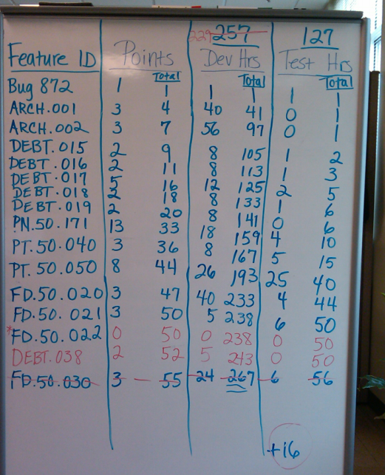
Sprint Planning Board

Slide 45

Sprint Planning – Team “Rules”
Rules enable the team to reach greater levels of productivity, for example:
Team hours and meeting attendance
Food, noise, hygiene, personal business, etc.
Team process standards:
Discuss and establish code writing and test standards
Establish code reviews and analysis, reuse, and coverage goal
Promote collaborative development
Determine Test Planning and how ‘Bugs’ will be handled
Determine the Team’s ‘Definition of Done’
How to handle ‘Flow through’ stories/tasks
Decisions regarding build and change management, and version control

Slide 46

Definition of Done
Determines EXACTLY what it means for the Team to be ‘Done’ with a User Story (or other Work Item Type)
Should eliminate all ambiguity as to whether an item is done or not done…there is no concept of ‘Partial Credit’ in Scrum
Defined by the Scrum Team

Slide 47
Definition of Done - Sample
All supporting code commented and checked in with successful build
Unit tests written: Code coverage >= 75%
Successfully deployed w/o errors to Test Environment
Meets all acceptance criteria
All test cases have been executed with results documented in Quality Center
Full regression testing has been performed
All high and critical severity bugs resolved
Any remaining medium and low severity bugs have a workaround approved by the Product Owner and have been moved to the product backlog
Product Owner sign-off on the story prior to Sprint Review
Any remaining task hours set to zero and status set to ‘Closed’ in Scrumwise

Slide 48
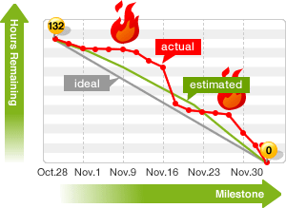
4 Scrum Ceremonies
Purpose:
Review updated Burndown chart to assess progress and adapt plan
Determine work for the next 24 hours
Identify impediments to progress
Advance the team’s level of project knowledge and Sprint Progress
Team answers three questions:
What I completed yesterday?
What I am committing to complete today?
3. What impediments I am experiencing?
Same place and time every day
Held around the Scrum Board
Time boxed 15 min
Sometimes called the Standup…why?
Only “Pigs” contribute unless “Chickens”
are specifically addressed
Daily Scrum

Slide 49
Impediments
Anything that is impeding an individual or the team in progressing towards the Sprint’s commitment.
Impediments raised become the SMs responsibility to resolve - ASAP!
Example Impediments:
I still haven't got the software I ordered a month ago.
I need help debugging a problem with ______.
I'm struggling to learn ______ and would like to pair with someone on it.
I can't get the vendor's tech support group to call me back.
Our new contractor can't start because no one is here to sign her contract.
I can't get the ____ group to give me any time and I need to meet with them.
The department VP has asked me to work on something else "for a day or two.“
The Product Owner hasn’t been available to answer my question on a specific UI question I have.

Slide 50
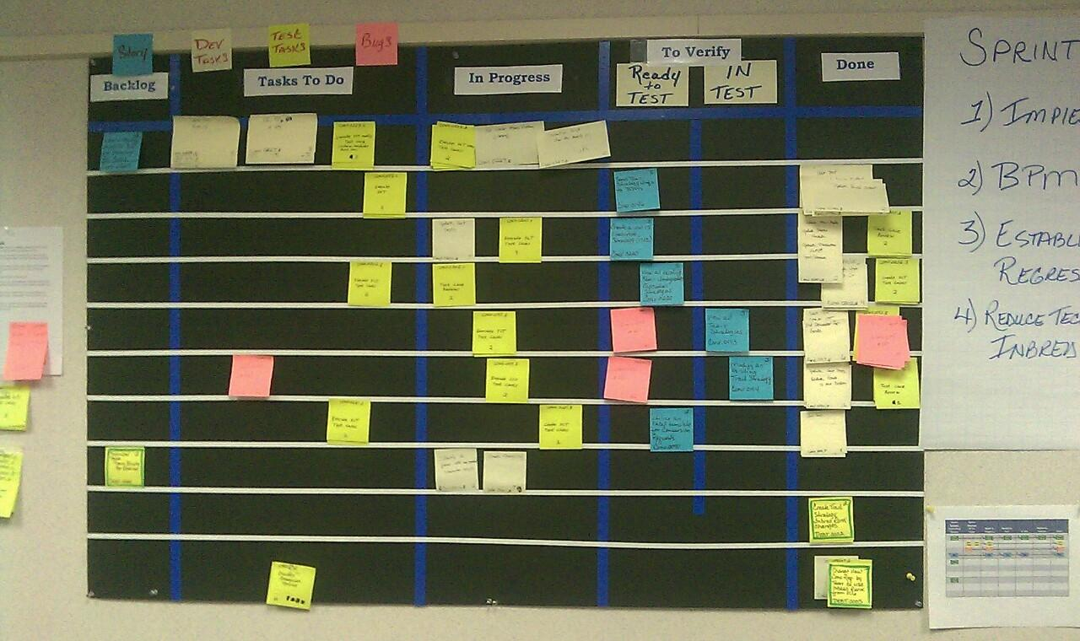
Sprint and Daily Scrum Scrum Board Example

Slide 51
Sprint Characteristics
Typically 2-4 weeks – shorter timeframe is generally better
Team builds and delivers a “potentially shippable increment” of functionality as determined by the commitment made at Sprint Planning
Team self-organizes to complete tasks identified during decomposition in Sprint Planning
Team reports on work at Daily Scrum and updates burndown
Team conforms to existing standards and conventions
Team CANNOT be interrupted during a Sprint

Slide 52
Exercise
1 - 10
I – X (Roman)
A - J

Slide 53

A little bit on Agile testing
Over-simplified, Agile testing is not much different than traditional testing practices, with one glaring exception -
TIMING
Testing done iteratively, i.e. Every Sprint, not at the end
Regression testing, notably Automated Regression, becomes more important much more quickly
TDD – Test Driven Development: Writing unit tests BEFORE writing code (Development Practice)
ATDD – Acceptance Test Driven Development: Writing Acceptance Tests AND unit tests BEFORE writing code (Team Practice)

Slide 54
4 Scrum Ceremonies
Held at the end of every Sprint to review accomplishments with the business
Demonstrate only ‘Done’ functionality
Time boxed to 1 hour per week of Sprint
Solicit input from attendees regarding the increment of functionality and the product
Inspect and Adapt – new stories will likely be identified
Review project progress to date and anticipated completion dates
Release Burn-up and Release Roadmap
Celebrate!!!!!!
Sprint Review

Slide 55
Sprint Review Characteristics
Occurs on the last day of Sprint
2 hours (2wk Sprint)
Invite “everyone else”
Must have active participation from users and stakeholders
Actively solicit commentary, feedback, critiques, etc.
DEMONSTRATE ONLY “DONE” STORIES
This is a demonstration of working software, not a slide show
Determine who will demonstrate what features
Include updated velocity, release schedule, impediments and any other information that is pertinent to Users and Stakeholders
Notes:
Together, the Sprint planning meeting, the Daily Scrum, the Sprint review,
and the Sprint retrospective constitute the empirical inspection and adaptation practices of Scrum

Slide 56
A Couple More Artifacts…
Release Planning - often referred to as a ceremony, however, its actually comprised of two, normally separate activities:
Pointing Sessions – Prerequisite for Release Planning
Release Planning
Activity designed to provide a schedule of anticipated software releases that will be usable by a set of customers
56
Notes:
Through Conversation, define tasks
Listen to different perspectives
Think about what needs to get done, not what my traditional role completes
Don’t . . .
make task too granular (don’t do 10 minute tasks)
Make task too large (1 sprint length)
Agree to the tasks
Team members sign up for tasks, NOT assigned by the Scrum Master
Estimate the task work
Can estimate ahead of time, but best after knowing who is accepting task
Validate capacity again; May need to refine stories in Sprint
Team Commits to Sprint
Fist of Five – Don’t Skip this Commitment
A note about tasks . . .
Any team member can add, delete, or change
Tasks (content, estimates, sign-up) can change (or emerge) during the Sprint
Don’t go back and refine Story Point (unless . . . )

Slide 57
Pointing Sessions
Points are used for one purpose and ONE PURPOSE ONLY…FORECASTING
Points and Velocity should NOT be used as a measure of performance. Why?
Each individual Team will estimate stories differently
Rewarding/punishing Teams based on Velocity will lead to the artificial inflation of point values assigned by the Teams
Notes:
Through Conversation, define tasks
Listen to different perspectives
Think about what needs to get done, not what my traditional role completes
Don’t . . .
make task too granular (don’t do 10 minute tasks)
Make task too large (1 sprint length)
Agree to the tasks
Team members sign up for tasks, NOT assigned by the Scrum Master
Estimate the task work
Can estimate ahead of time, but best after knowing who is accepting task
Validate capacity again; May need to refine stories in Sprint
Team Commits to Sprint
Fist of Five – Don’t Skip this Commitment
A note about tasks . . .
Any team member can add, delete, or change
Tasks (content, estimates, sign-up) can change (or emerge) during the Sprint
Don’t go back and refine Story Point (unless . . . )

Slide 58
Pointing Sessions
WHO: The Development Team points. PO does NOT. SM facilitates. RA can point…but should defer in most cases to the development team.
HOW: Planning Poker using the Fibonacci Sequence (1, 2, 3, 5, 8, 13) is common
Points are irrelevant of time… only estimate the complexity of the story (how big is it relative to others).
WHEN:
Sprint 0 for stories identified as Release 1
Towards the end of a Release for the next Release
‘As needed’ as additional stories are added for the current Release
Notes:
Through Conversation, define tasks
Listen to different perspectives
Think about what needs to get done, not what my traditional role completes
Don’t . . .
make task too granular (don’t do 10 minute tasks)
Make task too large (1 sprint length)
Agree to the tasks
Team members sign up for tasks, NOT assigned by the Scrum Master
Estimate the task work
Can estimate ahead of time, but best after knowing who is accepting task
Validate capacity again; May need to refine stories in Sprint
Team Commits to Sprint
Fist of Five – Don’t Skip this Commitment
A note about tasks . . .
Any team member can add, delete, or change
Tasks (content, estimates, sign-up) can change (or emerge) during the Sprint
Don’t go back and refine Story Point (unless . . . )

Slide 59

Pointing Sessions
Pointing is done based on the concept of ‘Relative Complexity’
Allows the Team to assign an estimate to each story without having to understand a great deal regarding the details
Team is charged with assigning a point value based on the perceived complexity of an individual story relative to all the other stories in the Product Backlog
Notes:
Through Conversation, define tasks
Listen to different perspectives
Think about what needs to get done, not what my traditional role completes
Don’t . . .
make task too granular (don’t do 10 minute tasks)
Make task too large (1 sprint length)
Agree to the tasks
Team members sign up for tasks, NOT assigned by the Scrum Master
Estimate the task work
Can estimate ahead of time, but best after knowing who is accepting task
Validate capacity again; May need to refine stories in Sprint
Team Commits to Sprint
Fist of Five – Don’t Skip this Commitment
A note about tasks . . .
Any team member can add, delete, or change
Tasks (content, estimates, sign-up) can change (or emerge) during the Sprint
Don’t go back and refine Story Point (unless . . . )

Slide 60
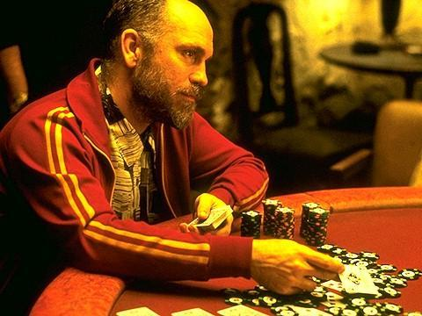
Pointing Sessions
Prediction is very difficult, especially about the future
Niels Bohr, Danish physicist
There's no sense being exact about something if you don't even know what you're talking about
John von Neumann, Mathematician
LET’S PLAY SOME CARDS!!
Notes:
Through Conversation, define tasks
Listen to different perspectives
Think about what needs to get done, not what my traditional role completes
Don’t . . .
make task too granular (don’t do 10 minute tasks)
Make task too large (1 sprint length)
Agree to the tasks
Team members sign up for tasks, NOT assigned by the Scrum Master
Estimate the task work
Can estimate ahead of time, but best after knowing who is accepting task
Validate capacity again; May need to refine stories in Sprint
Team Commits to Sprint
Fist of Five – Don’t Skip this Commitment
A note about tasks . . .
Any team member can add, delete, or change
Tasks (content, estimates, sign-up) can change (or emerge) during the Sprint
Don’t go back and refine Story Point (unless . . . )

Slide 61
Release Planning
A Release Plan should be created towards the end of Sprint 0 after:
Stories have been written for as much of the initial release as possible
Modules have been identified and stories categorized into these modules
A ‘representative’ number of stories have been pointed
At a minimum, all known stories for the highest priority module have been pointed
The Release Plan should be updated after every Sprint and reassessed by the Product Owner
Release Plan consists of two items
Release Burn-up
Release Roadmap
61
Notes:
Through Conversation, define tasks
Listen to different perspectives
Think about what needs to get done, not what my traditional role completes
Don’t . . .
make task too granular (don’t do 10 minute tasks)
Make task too large (1 sprint length)
Agree to the tasks
Team members sign up for tasks, NOT assigned by the Scrum Master
Estimate the task work
Can estimate ahead of time, but best after knowing who is accepting task
Validate capacity again; May need to refine stories in Sprint
Team Commits to Sprint
Fist of Five – Don’t Skip this Commitment
A note about tasks . . .
Any team member can add, delete, or change
Tasks (content, estimates, sign-up) can change (or emerge) during the Sprint
Don’t go back and refine Story Point (unless . . . )

Slide 62
Release Burn-up
Notes:
Through Conversation, define tasks
Listen to different perspectives
Think about what needs to get done, not what my traditional role completes
Don’t . . .
make task too granular (don’t do 10 minute tasks)
Make task too large (1 sprint length)
Agree to the tasks
Team members sign up for tasks, NOT assigned by the Scrum Master
Estimate the task work
Can estimate ahead of time, but best after knowing who is accepting task
Validate capacity again; May need to refine stories in Sprint
Team Commits to Sprint
Fist of Five – Don’t Skip this Commitment
A note about tasks . . .
Any team member can add, delete, or change
Tasks (content, estimates, sign-up) can change (or emerge) during the Sprint
Don’t go back and refine Story Point (unless . . . )

Slide 63
Release Roadmap
Notes:
Through Conversation, define tasks
Listen to different perspectives
Think about what needs to get done, not what my traditional role completes
Don’t . . .
make task too granular (don’t do 10 minute tasks)
Make task too large (1 sprint length)
Agree to the tasks
Team members sign up for tasks, NOT assigned by the Scrum Master
Estimate the task work
Can estimate ahead of time, but best after knowing who is accepting task
Validate capacity again; May need to refine stories in Sprint
Team Commits to Sprint
Fist of Five – Don’t Skip this Commitment
A note about tasks . . .
Any team member can add, delete, or change
Tasks (content, estimates, sign-up) can change (or emerge) during the Sprint
Don’t go back and refine Story Point (unless . . . )

Slide 64

Release Planning
Decision making based on Release Plan
Time (Schedule)
Cost (Resources)
Scope
Notes:
Through Conversation, define tasks
Listen to different perspectives
Think about what needs to get done, not what my traditional role completes
Don’t . . .
make task too granular (don’t do 10 minute tasks)
Make task too large (1 sprint length)
Agree to the tasks
Team members sign up for tasks, NOT assigned by the Scrum Master
Estimate the task work
Can estimate ahead of time, but best after knowing who is accepting task
Validate capacity again; May need to refine stories in Sprint
Team Commits to Sprint
Fist of Five – Don’t Skip this Commitment
A note about tasks . . .
Any team member can add, delete, or change
Tasks (content, estimates, sign-up) can change (or emerge) during the Sprint
Don’t go back and refine Story Point (unless . . . )

Slide 65
Release Planning
Establish the release goals
Consider business value, size, risk, and dependency
Select stories for the release, considering:
The desirability of the feature to a broad base of users or customers.
The desirability of the feature to a small number of important users or customers.
The cohesiveness of the story in relation to other stories.
When do we want to release?

Slide 66
4 Scrum Ceremonies
Continuous Improvement opportunity held at the end of every Sprint after the Review
An opportunity for the Team to ‘Inspect and Adapt’
Time boxed to 1 hour per week of Sprint
Answer three questions:
What went well?
What didn’t go so well?
What action items will we take to improve going forward?
Input should be received from all Scrum Team members
Stakeholders, Users and “Everyone Else” are NOT invited to the Retro. Product Owner?
Facilitated by the Scrum Master
Sprint Retrospective

Slide 67

Velocity Challenge
Objective: Score as many points as possible in 2 minutes
Rules:
• A ball passed to each person, returned to the starting person, and returned to box scores a point
• Each ball must be touched by each person
• Each ball must spend time in the air during each pass between people
• A ball cannot be passed between two nearest neighbors (left/right)
• Balls may be reused
• A ball that hits the floor is not counted (These are defects)
Play:
• 3 min to define your process
• Estimate
• 2 min to move the balls
• Record your score
• 3 min to ‘retrospect’ and re‐estimate
• Repeat 4 times

Slide 68
Scrum Overview Putting the framework and Roles, Artifacts and Ceremonies in place
Daily
Scrum
Release Planning
(Iterative R2,R3, Rn
Sprint
(Iterative)
Product
PO Vision
Features
Roadmap
Goals
Product Backlog
User Stories
Epics
‘Right
size’
Story
Release
Planning
Pointed
Prioritized
Add
Story
Detail
AC
Sprint
Planning
Understand
Define Tasks
Commit
2-4 hours
Sprint
Develop, test
2-4 weeks
Daily Scrum
15min
Sprint
Review
Demo
Accept
2-4 hrs
Retrospective
Continuous improvement
~2 hrs
Notes:
The scrum iterative process “on a page”
We will use this to graphically throughout to demonstrate the Scrum framework, roles, actions
White board this solution.

Slide 69
Review
What is velocity?
Rolling average of the total story points completed per Sprint.
Anyone can participate in the Daily Scrum.
False. If you are not a part of the development team or the Scrum Master, you may only speak if addressed.

Slide 70
Review
The Daily Scrum is an opportunity for the team to give the Scrum Master their status.
False. This is an opportunity for the team members to update the team and plan for the next day. This is not a report to the Scrum Master.
Anyone may attend the Sprint Review.
Yes. The Sprint Review is an opportunity to share what was accomplished and to get feedback from the stakeholders and users.

Slide 71
Review
What sprint ceremony allows the team to reflect on the last sprint?
Sprint Retrospective
What are the three questions that help guide the Sprint Retrospective?
1. What went well? 2. What did not go so well? 3. What action items will we take to improve going forward?

Slide 72
Review
When does the team decompose the stories into tasks?
Sprint Planning
Sprint Planning is the time for the team to “solve” the story.
False. The team identifies the tasks needed to complete a story but this is not the time to determine how.

Slide 73
Review
A story needs to have all of the detail before it can be added to the backlog.
False. The stories in the backlog are initially at a high level. The detail does need to be added prior to Sprint Planning.
The Product Owner can add stories to the sprint at anytime.
False. Once the team has committed to the stories they will complete in the sprint, the Product Owner commits to not adding stories.

Slide 74
Review
It’s ok to code more than what the acceptance criteria calls for, especially if I know it’s in a future story.
NO! Keep it simple. Only code what is needed in order to meet the acceptance criteria.
Why?
1. Customer needs change 2. Priorities change 3. Creates the need for additional tasks 4. Domino effect

Slide 75
Kanban Overview
Japanese for a visual signal (“kan”) card (“ban”) or “signboard”
Toyota developed “kanbans” to control production between processes for Just In Time (JIT) manufacturing in late 1940s
David Anderson first to apply kanban techniques to software
Start with what you know
Agree to incremental, evolutionary changes
Initially respect current processes, roles, and responsibilities

Slide 76
Scrum and Kanban Similarities
Both are Lean and Agile
Both use pull scheduling (Scrum at the beginning of iterations, Kanban on a continual basis)
Both limit WIP (work in progress) (Scrum at the beginning of iterations, Kanban on a continual basis)
Both use transparency to drive process improvement
Both focus on delivering business value (software, services, etc.) early and often
Both are based on self-organizing teams
Both use empirical data to continuously update and optimize release plans.
Prioritized items are worked on first.
“Kanban vs Scrum; How to make the most of both,” Henrik Kniberg, 2009

Slide 77
Scrum and Kanban Differences
Scrum | Kanban
Timeboxed iterations prescribed | Timeboxed iterations are optional
Team commits to a specific amount of work each iteration | Team commits to a WIP limit (Work in Progress)
Uses Velocity as metric to planning and process improvement | Uses Lead Time as metric for planning and process improvement
Cross-functional teams generally prescribed | Cross-functional teams are optional; specialist teams are allowed
WIP limited indirectly (through sprint velocity and commitment) | WIP limited directly (through workflow state)
Cannot add items to ongoing iteration | Can add new items whenever capacity is available
Prescribes three roles (PO, Team, SM) | No prescribed roles
Scrum board is reset after every iteration | Kanban board is persistent

Slide 78
Five (or 6) Core Practices
Visualize using kanbans or story cards
Limit WIP (Work in Progress)
Manage flow continuously
Make exit policies explicit
Improve collaboratively evolve experimentally through small continuous evolutionary changes that stick
Implement feedback loops using metrics and indicators (a scientific empirical approach)

Slide 79
Kanban Board / Mechanics
Ready (4)
Analysis (2)
Development (4)
Test (3)
Ready to Deploy
Deployed
In Progress
Done
In Progress
Done
10
9
8
5
4
1
11
6
2
12
7
3
13
14
Here is an example Kanban board. Notice the stages of the process, represented as columns. Notice the WIP limits in parentheses beside the column names.
Let’s say testing of ticket 1 is complete. We move it downstream to indicate that it is ready to deploy.
Now we have 2 items in Test, with a WIP limit of 3, so we may pull a ticket from Development Done into Test, leaving 3 in Development, which has a WIP limit of 4, so we may pull a ticket into Development from Analysis Done, and so forth.
Because our WIP limit in Development covers both In Progress and Done, when we complete development on a ticket, we may move it to the Development Done column to indicate that it is completed, without breaking a WIP limit.
WIP limits stop work being pushed downstream when there is insufficient capacity to receive the work. If development work on ticket 5 is completed, it cannot be “pushed” into Test, because Test is already at its WIP limit.
A ticket completes Testing, a slot comes free, and ticket 5 may now be pulled into Test.
The Ready queue may be replenished to its WIP limit with new work from the customer.

Slide 80
Key Metrics
Lead Time (LT)
Lead Time – time from customer request until delivery
Cycle Time (CT)
Cycle Time - time work starts until it’s delivered
Throughput - number of kanbans done in a period of time, used as an indicator of how well a system (team, organization) performs
Kanbans requested to be done
Kanbans that are done
Active Kanbans (WIP)

Slide 81
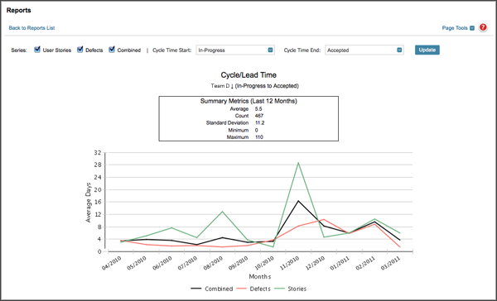
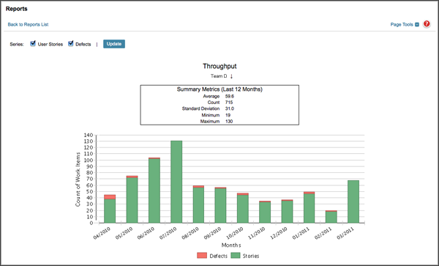
Key Reports

Slide 82
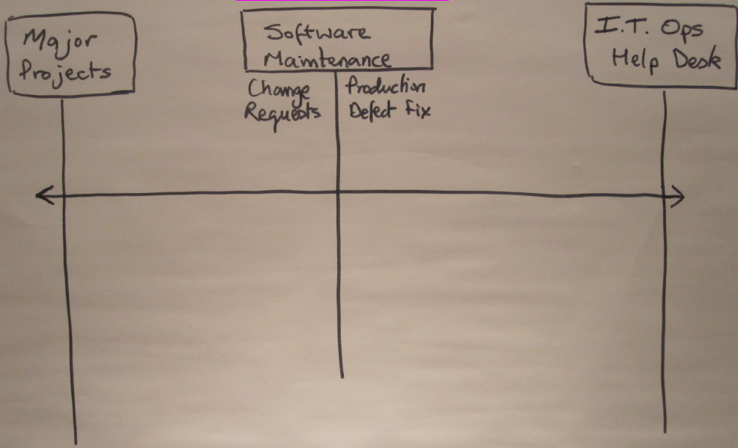
Where does Kanban work well?
Throughput
Value Demand
Failure Demand
Lead Time
As decoupled cadences and single-piece flow have little benefit in this space, it stands to reason Kanban is not useful here!
The sweet spot for Kanban lies in software maintenance or rather processing of change requests (value demand) and product defect repair (failure demand)
Kanban’s decoupled cadences (no time-boxed iterations) and single-piece flow make it a natural fit for this space!
Source: “Kanban: when is it not appropriate?” by David Anderson

Slide 83
Retrospective
What went well?
What didn’t go so well?
What can be improved going forward?

Slide 84
Resources
http://www.agilemanifesto.org
http://www.scrum.org
Mike Cohn, Mountain Goat Software LLC, http://www.mountaingoatsoftware.com
Scrum Alliance (http://www.scrumalliance.org)
Agile-software-development.com, “How to Implement Scrum in 10 Easy Steps”, http://www.agile-software-development.com.
Sizing Agile Projects with Fibonacci, October 12th, 2009 | Published in Agile, General, Methodology at nexidecimal.com.
Agile Project Management with Scrum by Ken Schwaber
Scaling Lean & Agile Development by Craig Larman and Bas Vodde
Succeeding with Agile – Mike Cohn
Agile Estimating and Planning – Mike Cohn
User Stories Applied (For Agile Software Development) – Mike Cohn
Agile Software Development with Scrum – Ken Schwaber / Mike Beedle

